Slide 1
AI Engineering Capstone - Restaurant Recommendation
IEOR 4574
Jiaying Du (jd4234), Minghao Li (ml5190), Siyuan Kong (sk5501), Zekai Su (zs2704)

Slide 2
Content
Background & Motivation
Methodology
Evaluation
Conclusion

Slide 3
Existing Problem
Time Constraints
Lack of Personalized Recommendations
Spend too much time in
  Choosing restaurants
  Deciding the order of visits
Current map only shows nearby places and restaurants
Notes:
People often spend too much time choosing restaurants and deciding the order of visits, especially when plans are only partially made
Current map services show nearby places and restaurants but lack personalized recommendations

Slide 4
Our Goal
“We aim to build a system that, given a user’s location, time window, preferences, and any fixed stops, creates a realistic day plan”

Slide 5
Full Product Vision
Apply to All Places
Realistic Scheduling
Context Aware Planning
Be able to plan routes and make recommendations for all locations around the world
Uses location, time window, preferences, and fixed stops to design the day
Builds an ordered sequence of stops with true to life travel times and buffer periods
Constraint Handling
Intended Users
Rich Recommendations
Can set budget, transport mode, accessibility needs, food type, and group size
Suggests restaurants, tourist sites, stores, and other points of interest
All people who desired a feasible plan
Notes:
Intelligent day planning assistant that creates realistic, end-to-end itineraries for locals and travelers
Uses a user’s location, time window, preferences, and fixed stops to generate a curated, feasible day plan
Produces an ordered sequence of stops with realistic travel times and buffer periods
Lets users specify constraints such as budget, transport mode, accessibility needs, and group size
Be able to recommend restaurants, tour sites, stores etc.

Slide 6
Methodology - Approach 1
Sourced from NYC Open Data
  4,621 restaurants in Manhattan
Local LLMs via Ollama(gemma3:12b)
  8.1G of space needed
Example prompt:
  Hi, can you give me some restaurant recommendations near Columbia University?
  Location & cuisine genres are not required, but recommended to provide to LLM

Slide 7
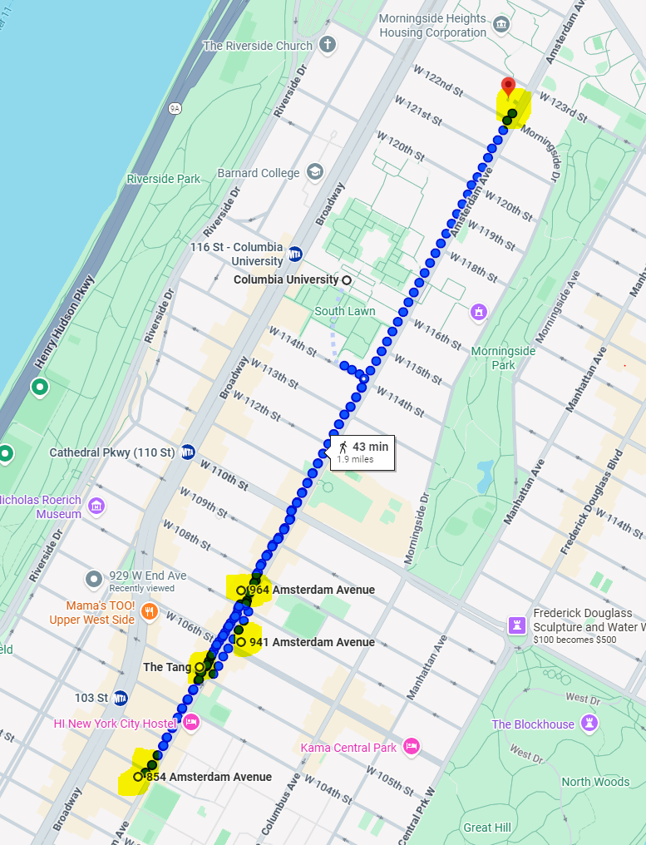
Methodology
All within walking distance from main campus
Different cuisine genres as not prompted

Slide 8
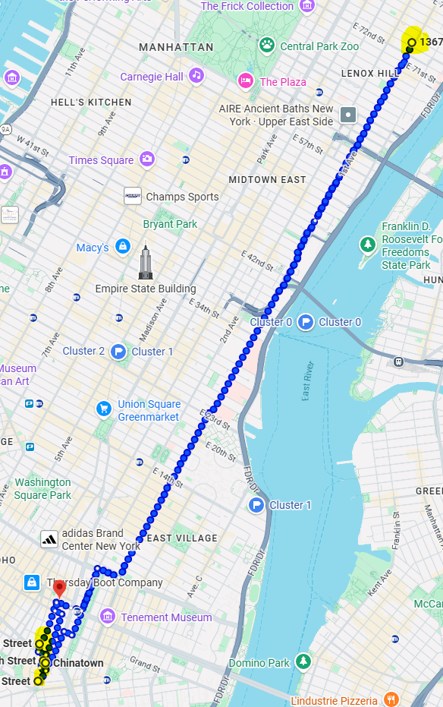
Methodology
Prompt: recommendation near Chinatown
Not doing well when locations are a little ambiguous

Slide 9
Methodology - Approach 2
Final Solution

Slide 10
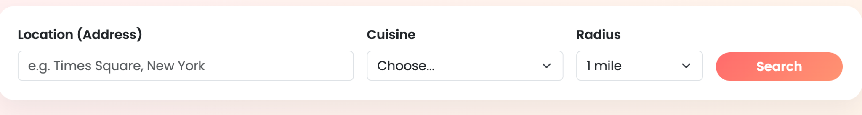
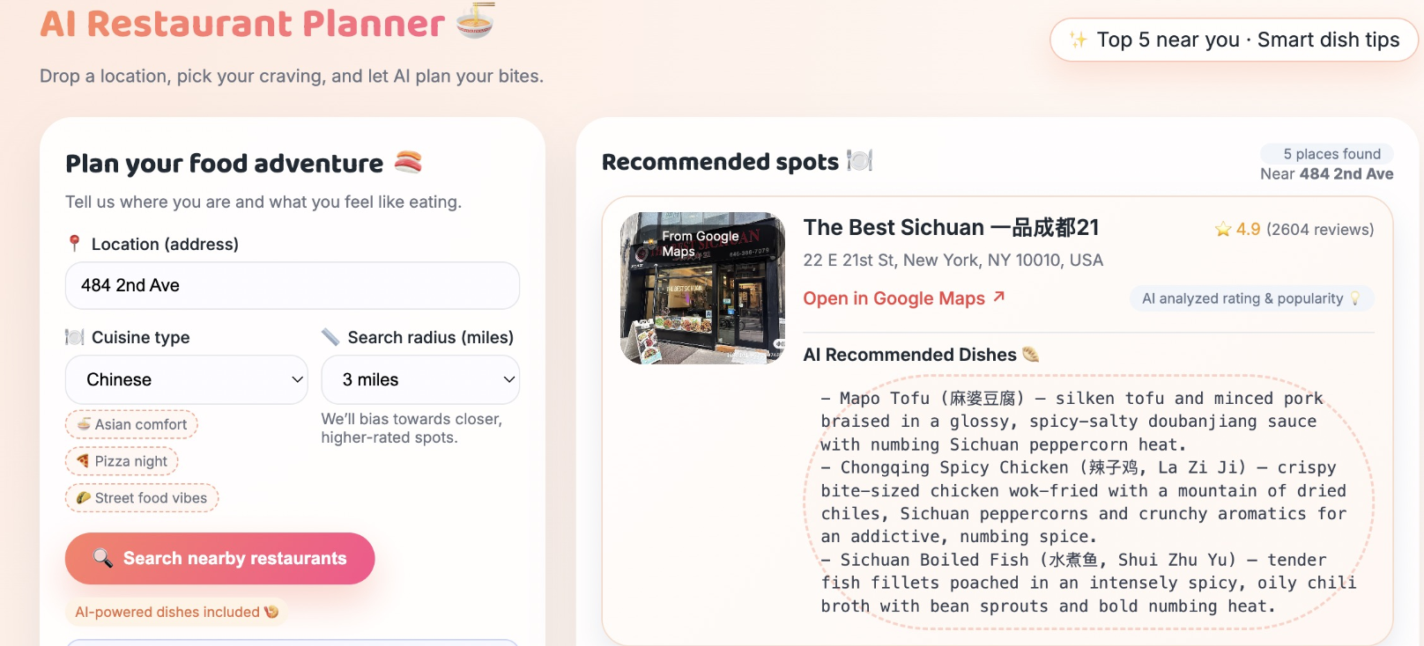
Technical Diagram
User Browser
(Search Form)
Flask Web App
(Restaurant Finder)
LLM (Gemini)
(Dish Suggestion)
HTML Result Page
Top 5 + Dishes
Google Geocoding API
(Address → lat/lng/city)
Search through google review to provide recommendations
Google Places API (New)
(Nearby Restaurants)

Slide 11
DEMO
‹#›

Slide 12
Conclusion
Solves restaurant choice: providing a clear, curated Top-5 recommendation list.
Evolved from a local LLM + static dataset prototype to a real-time Google Maps + LLM system.
Grounded geospatial data ensures accurate, trustworthy restaurant suggestions.
LLM adds contextual value with dish recommendations, enhancing decision confidence.
Demonstrates that simplifying inputs and outputs leads to faster, better user decisions.

